Slide 1
Hyperparameter Database
Ananya Yadav
Ashrith Pradeep
Keerthana Siva

Slide 2
Description
The hyperparameter database is a public resource with algorithms, tools, and data that allows users to visualize and understand how to choose hyperparameters that maximizes the predictive power of their models. The hyperparameter database is created by running millions of hyperparameter values, over thousands of public datasets and calculating the individual conditional expectation of every hyperparameter on the quality of a model.
The dataset being used here is Housing Price Dataset:
Housing prices dataset consists of attributes on which the price of the house depends. The dataset includes prices for 50000 houses and other columns taken into consideration will be factors which might affect the prices.
The attributes included here are Area, Garage, FirePlace, Baths, White Marble, Black Marble, Indian Marble, Floors, City, Solar, Electric, Fiber, Glass Doors, Swimming Pool, Garden and Prices.

Slide 3
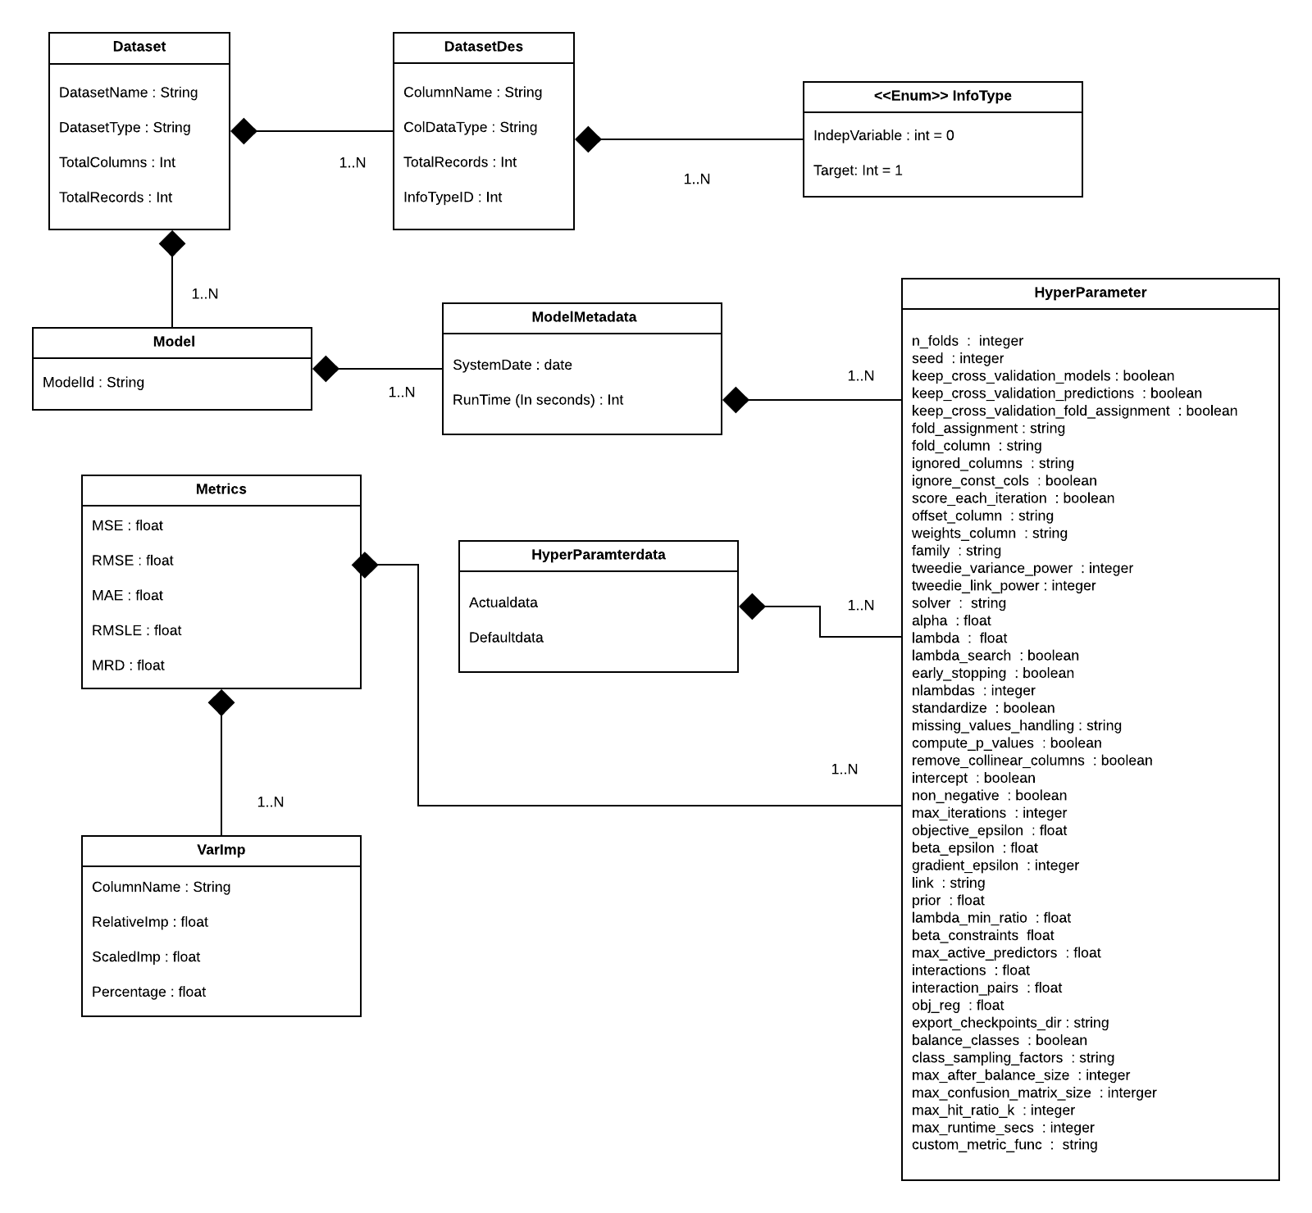
UML Diagram

Slide 4
